Slide 1

DEPARTMENT OF COMPUTER SCIENCE & ENGINEERING
SCHOOL OF COMPUTING
1156CS701- MAJOR PROJECT
IN-HOUSE
WINTER SEMESTER(2023-2024)
REVIEW - I
“Block chain Land And Flat Registry Platform-Reducing Frauds and Delays”
SUPERVISED BY
Dr. ARUNA
PRESENTED BY
DAYASAGAN K(12056)(20UECS0395)
ARUL SIVA P(17237)(20UECS0674)
RUDHRA KUMAR M(12071)(20UECS0546)

Slide 2
AGENDA
ABSTRACT
OBJECTIVE
INTRODUCTION
LITERATURE REVIEW
DESIGN AND METHODOLOGIES
IMPLEMENTATION
CONCLUSION
REFERENCES

Slide 3
ABSTRACT
In the traditional Land and House Registration system practiced in India, there exists a middle man (broker) who establishes a contact between the buyer and seller, for instance if an individual wants to buy or sell a property ,the broker will create and assemble all the obligatory physical documents with regards to an agreement as a proof of property.
Brokers will ensure that the land & house property would be registered by an authorized government office where all the attributes are noted down in a ledger and thereafter the whole transaction and purchase Ent between the two parties takes place.
In this scenario ,there are chances of losing or tampering of the documents as anyone with certain powers can access or alter the papers easily which in turn threatens this concrete proof of land & house.
Thus, this type of system as compared to our proposed system in which we make use of a smart contract to deal with the assets and transactions among the participants, is relatively time consuming, less secure and unsynchronized where activities including corruption and fraudulence might be associated during the execution of the required process.

Slide 4
ABSTRACT:
With an amalgam of inspection and analysis regarding the old accustomed way and considering that Innovative Resistance has an increased transparency and integrity maintenance along with the portability factor, we put forward a Innovative Resistance based land & house registration system which provides a transparent, secured and decentralized method for execution of transactions between the participants by employing the concept of hyper ledger.
Index Terms Innovative Resistance Land & House, Hyper ledger, land & house registration.

Slide 5
OBJECTIVES
Aim of the Project:
Utilize blockchain technology to create a secure and transparent registry platform. Minimize fraudulent activities through immutable record-keeping. Streamline transaction processes using smart contracts to reduce delays. Enhance trust and accountability among stakeholders by providing real-time access to registry data. Improve efficiency and lower transaction costs by automating registry operations.

Slide 6
SCOPE OF PROJECT:
The Land&House registration system incorporating Innovative Resistance using Innovative Resistance provides features like registration of owner and land & House by uploading mandatory verified documents.
After verification of the owner/land using smart contract using smart contract and consensus protocols implemented in the model , land can be put up for the sale and then assets will be visible to all the potential buyers.
Simultaneously the sale revenue of the land including stamp duty, cost of the land as per the official criteria and registration fees is calculated automatically and the final selling cost of land is generated.
After agreement between both the parties, purchase Ent of land & House gets completed and transactions are recorded and added to the Innovative Resistance Thus, this system stores the history of transactions and backup data in blocks which is immutable.

Slide 7
INTRODUCTION
In recent times, a lot of problems are faced by commercial real estate industries and land registration systems where even though the data is in digital form , they are stored on disparate systems and thereby lack transparency, trust and efficiency.
The intention is to implement a small module of the land registration process with regards to the state of Maharashtra.
We propose a private and permissioned Innovative Resistance system that restricts the participants who can contribute to the consensus process ,to overcome the obstacles faced earlier as mentioned Our Innovative Resistance system makes use of Asymmetric cryptography for security of users and distributed consensus algorithms for ledger consistency.
The main features of Innovative Resistance technology are decentralisation, persistence, anonymity and auditability and an amalgam of these results in reduced cost and improved efficiency, reliability.

Slide 8
LITERATURE REVIEW
In the last few years, there have been some papers published on the topic of BC and BCT using bibliometric analysis .Later in this chapter, the research focus will be on papers that were published concerning the combination of BC and land issues (LA, LR, LC,LM and land registration). A very important term on which everything else concerning land (in the context of this paper) relies on is good governance.
By analyzing its eight major points (rule of law, responsiveness, equity and inclusiveness, accountability, participation, transparency, consensus orientation and effectiveness and efficiency) , it can be concluded that it is the basis to which a BCT can very easily fit in.

Slide 9
DESIGN AND METHOLOGIES
MODULE 1:
MODULE 2:

Slide 10
MODULE:1
Module 1 Title
Step:1 Step 1 Title
*Include execution screenshots with Timestamp
*Include flow of execution
*Include algorithms

Slide 11
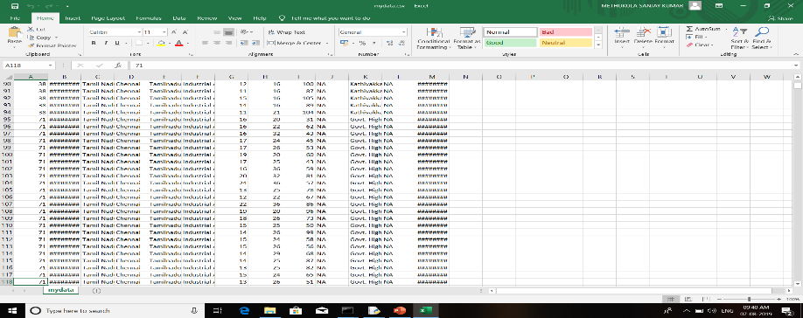
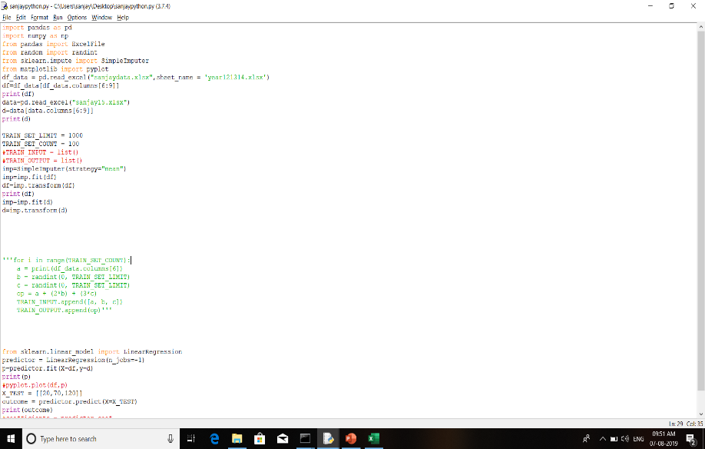
Step 2: Processing of data
Step 3: Apply Machine Learning Algorithms

Slide 12
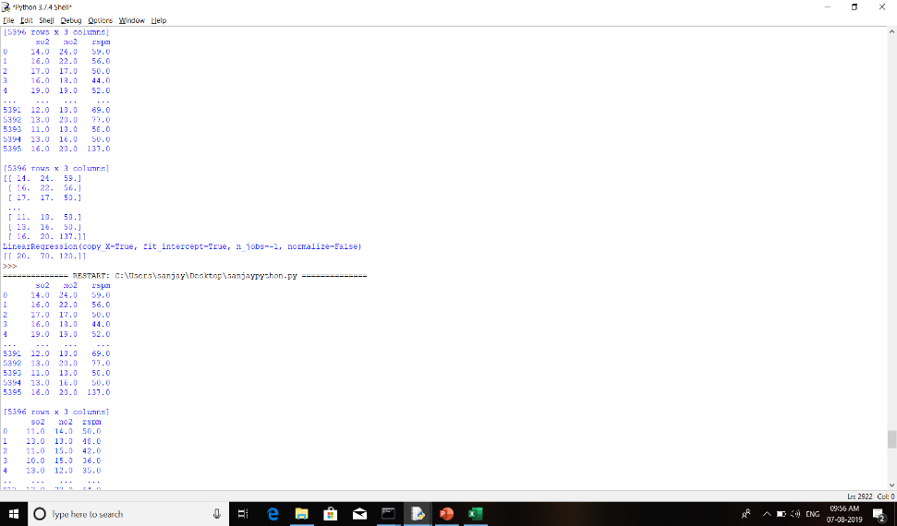
Step 4: Get the Output

Slide 13
IMPLEMENTATION
Architecture Diagram
Data –Flow Diagram
Use Case Diagram
Class Diagram
Activitiy Diagram
Sequence Diagram
Colloboration Diagram(If applicable)
E-R Diagram

Slide 14
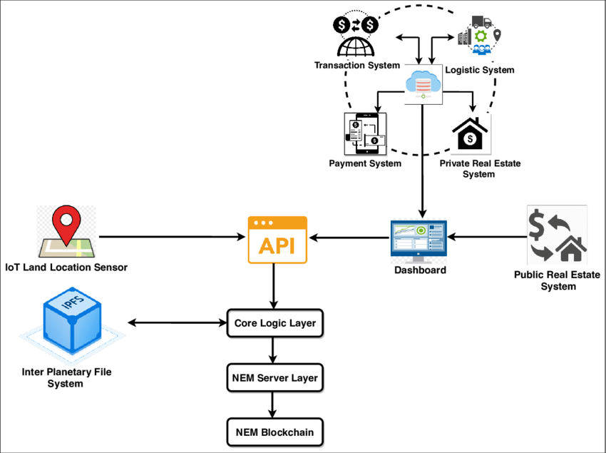
ARCHITECTURE DIAGRAM

Slide 15
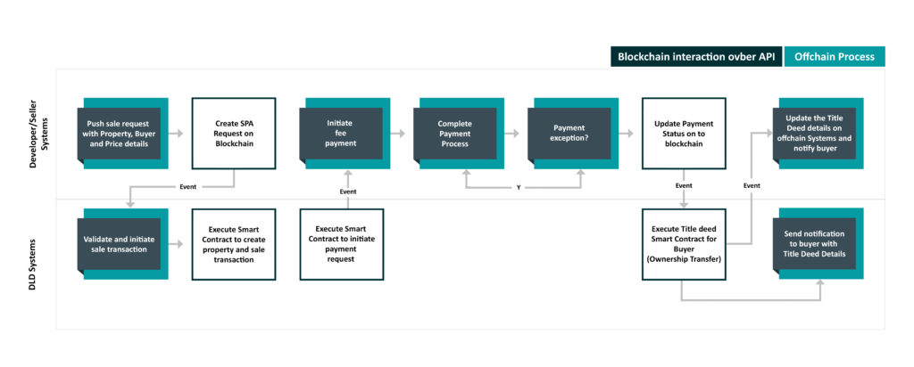
DATA FLOW DIAGRAM

Slide 16
Use Case Diagram

Slide 17
Class Diagram

Slide 18
Activitiy Diagram
Start
Land and Flat Registry Platform
User Interaction
Select Action: Register Property, Update Ownership, Record Transfer
Transaction Processing
Mine Transactions into a Block Validate Block Add Block to Blockchain Broadcast Updated Blockchain
End

Slide 19
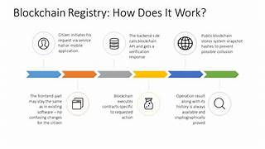
Sequence Diagram

Slide 20
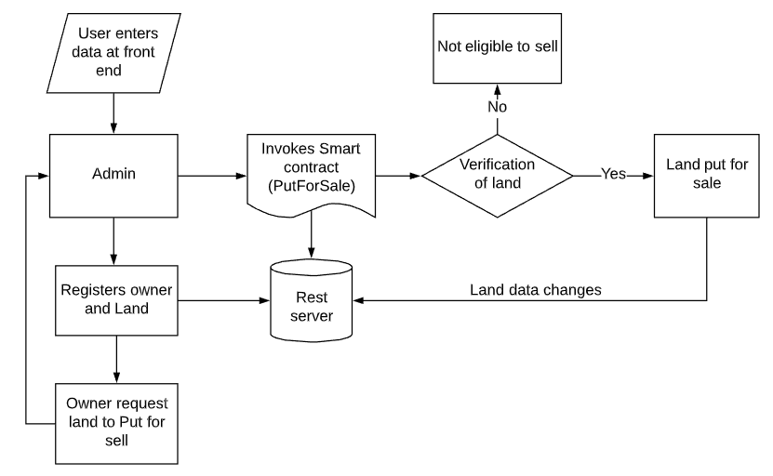
E-r dIAGRAM

Slide 21
REFERENCES
[1] N.S.Tinu(2018), A Survey on Innovative Resistance Technology Taxonomy, Consensus Algorithms and Applications.
[2] J. Michael Graglia, Christopher Mellon, Innovative Resistance and Property in 2018 : At end of the Beginning.
[3] Raquel Benbunan-Fich, Arturo Castellanos(2018) Digitalization of Land Records: From Paper to Innovative Resistance.

Slide 22
[4] IBM, State Street Corp. Hyper ledger Fabric: A Distributed Operating System for Permissioned Innovative Resistance.
[5] Miroslav Stefanovic, Dorde Przulj, Darko Stefanovic(2018) Blockchain and Land Administration : Possible applications and limitation.

Slide 23
THANK YOU

